Slide 1







Autonomous Air transportation
AC Design
Using Vision Navigation
Flight test
Autopilot
Introduction
Implementation
Computer Vision
Supervised by: Asst. Prof. Osama Saaid

Slide 2
Introduction

Slide 3
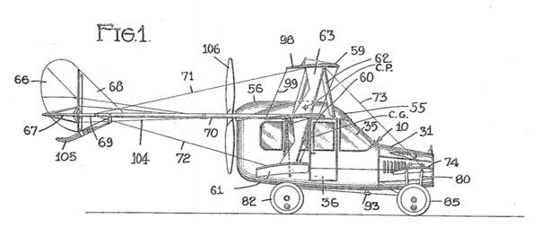
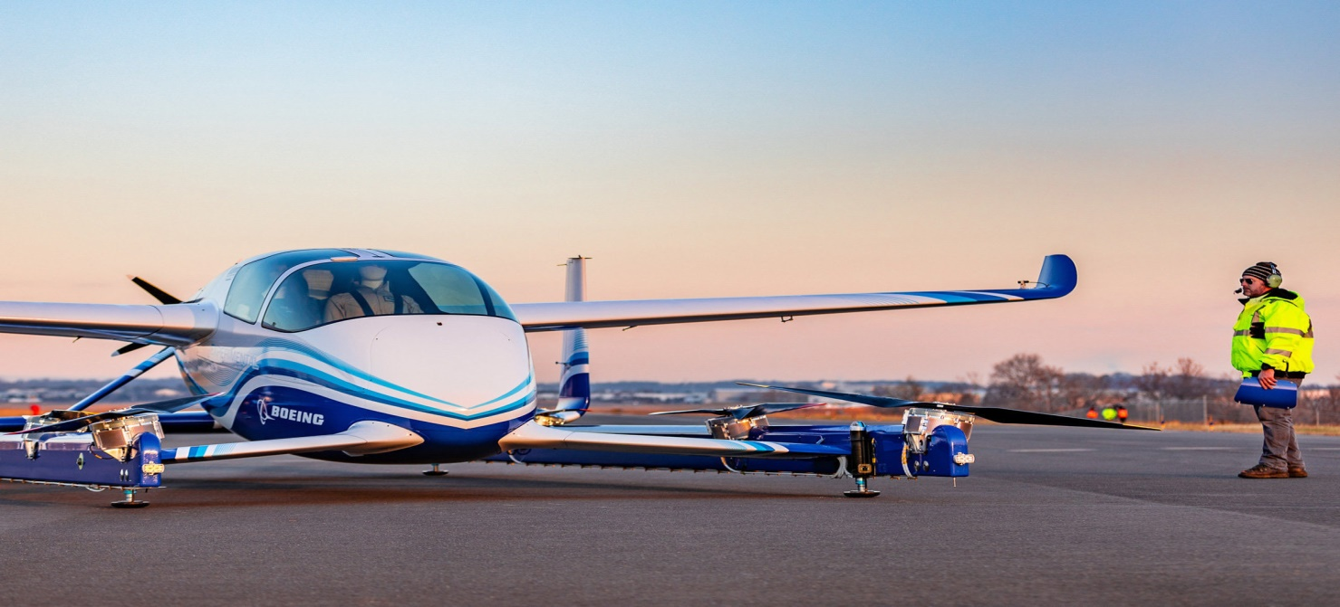
Flying Taxi
a flying vehicle with a range of 50 to 120 miles, carrying one to four passengers, and cruising at an altitude of 3,000 to 5,000 feet.

Slide 4
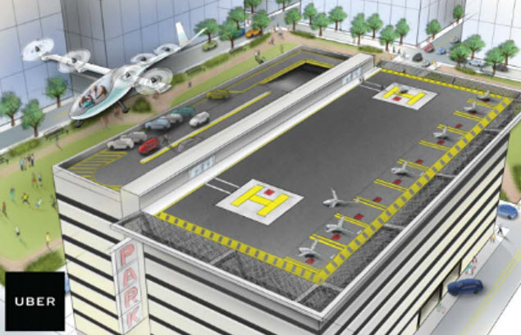
Why attractive idea
Traffic jam problem
Infrastructure cost
Reduce emission and improve safety
Obstacles we need to pass
Energy limitations
The public is ready to fly aboard an air taxi with no pilot
Our current air traffic control systems doesn’t accommodate air taxies

Slide 5

Flying taxi categories
Passenger drone:
Electric or hybrid electric
Move people or cargo
Manually piloted, remotely piloted or fully autonomous
Cover short to medium range up to 65 miles
will take flight by 2020

Slide 6
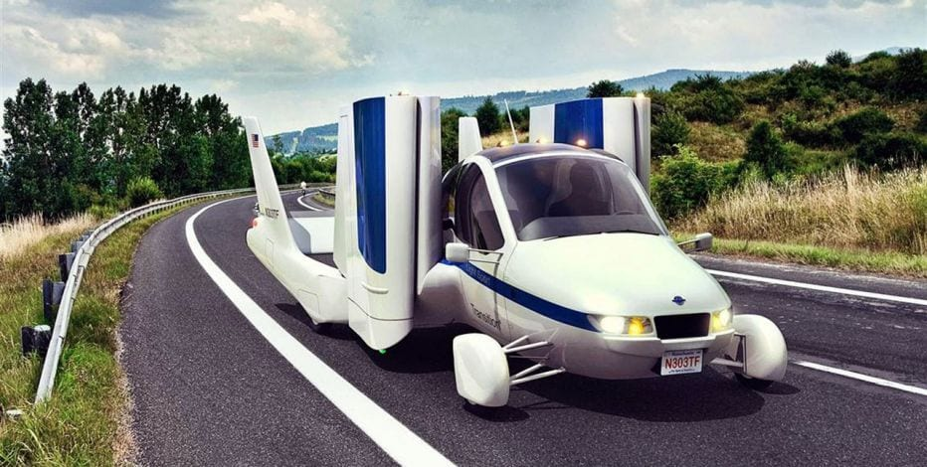
Flying taxi categories
Traditional flying cars:
Can be driven in car configuration to the airport then change it to airplane mode
Need licensed pilot
Cover medium to long range
will take flight by 2020-2022

Slide 7
Flying taxi categories
revolutionary vehicles:
combine a passenger drone and traditional flying car
Fully autonomous vehicle
Cover long range (greater than 200 miles)
Have advanced VTOL capability
It could take until 2025 before they become a reality

Slide 8
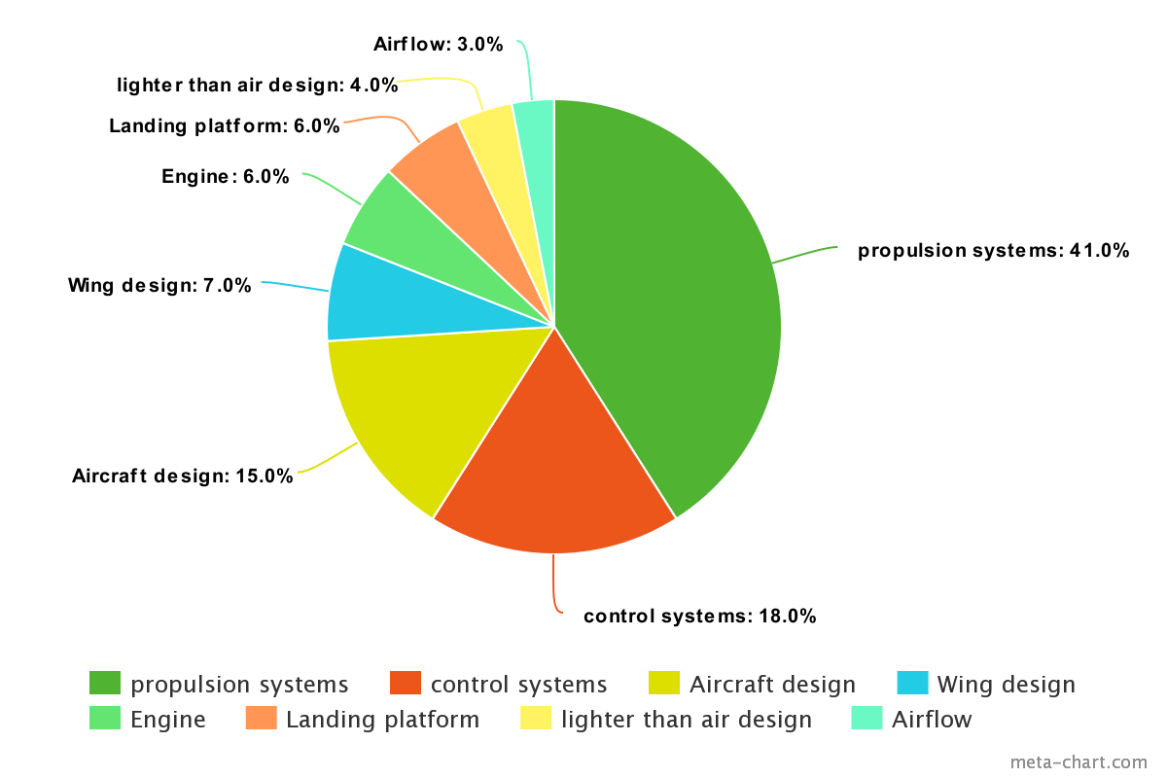
Technology areas dominating air taxi technology

Slide 9






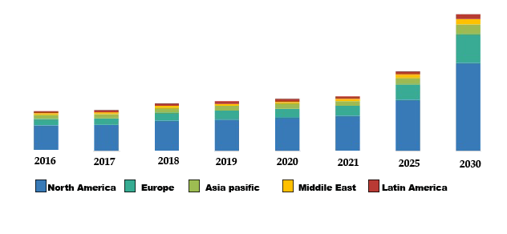
The key players in the flying car space

Slide 10

The key players in the flying car space
Boeing flying taxi:
Has completed the first test of its autonomous electric VTOL

Slide 11
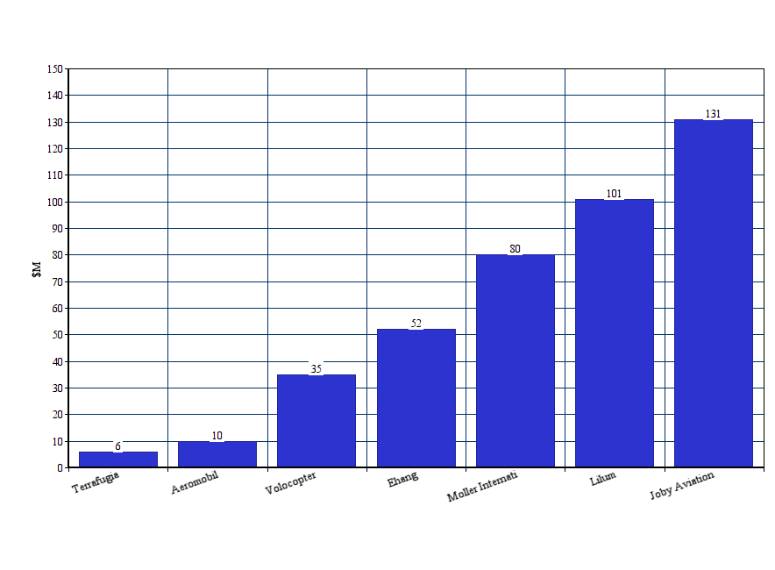
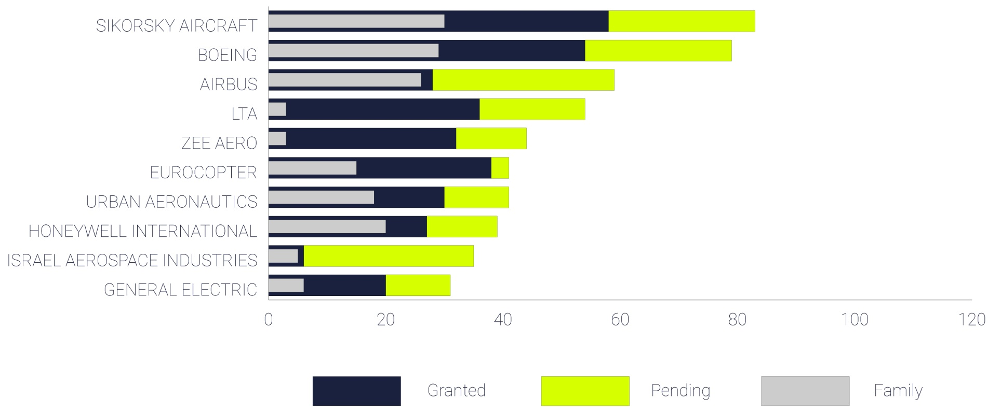
The key players in the flying car space
Patent portfolio:
Funding raised by flying taxi startups:

Slide 12
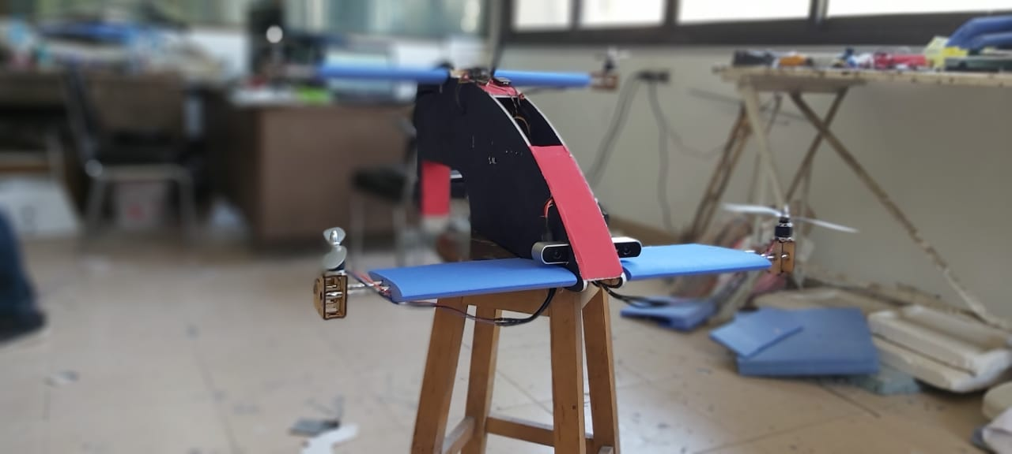
Our prototype

Slide 13

AC Design

Slide 15

Autopilot

Slide 16
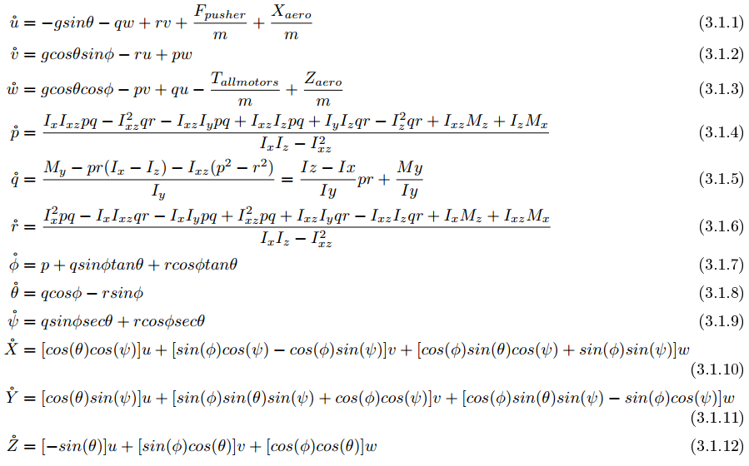
Nonlinear mathematical model

Slide 17
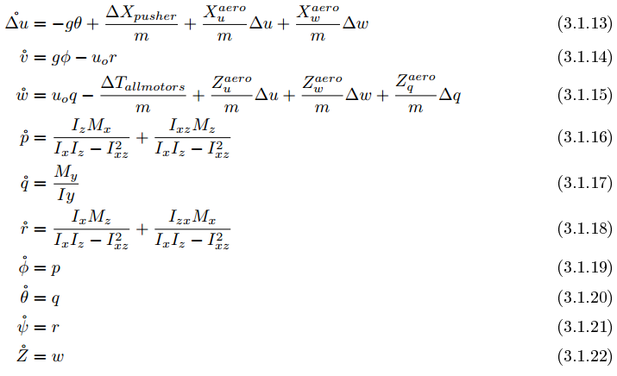
Quad-plane phase Linear model
Steady-state : all rates = 0 , φ = θ = 0 , α =0

Slide 18
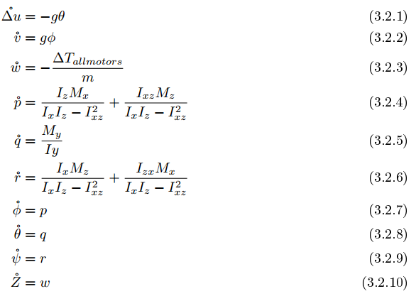
Quad-copter phase Linear model

Slide 19
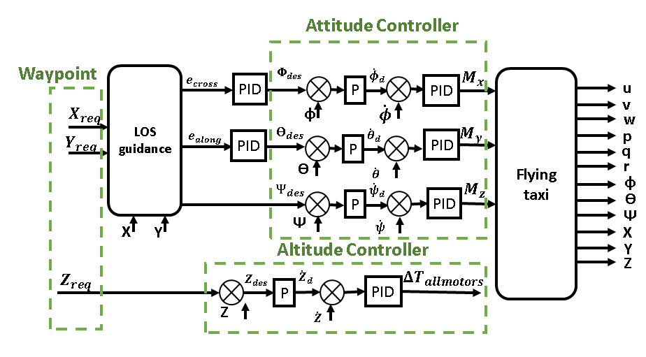
Quad-copter phase Autopilot

Slide 20
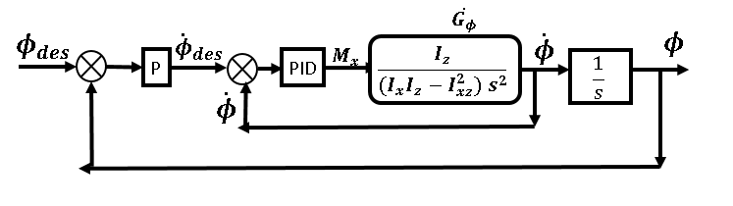
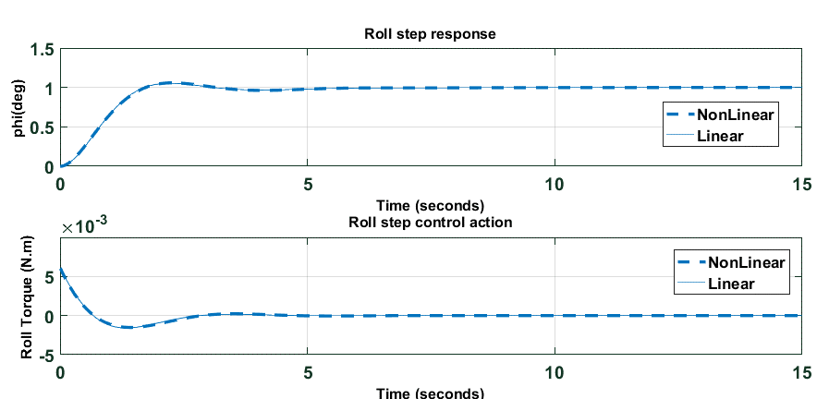
Attitude controller: Roll Controller
1 deg step response & control action

Slide 21
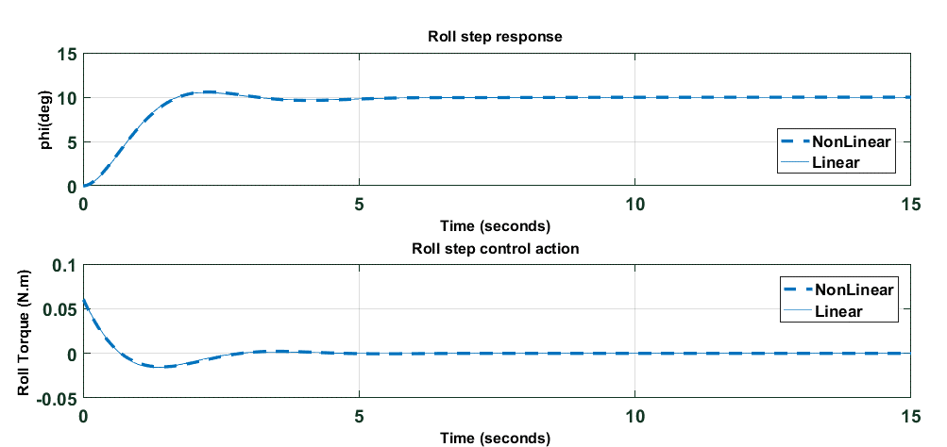
Attitude controller: Roll Controller
10 deg step response & control action

Slide 22
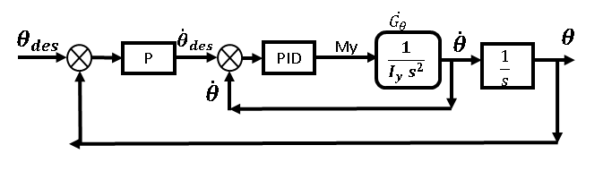
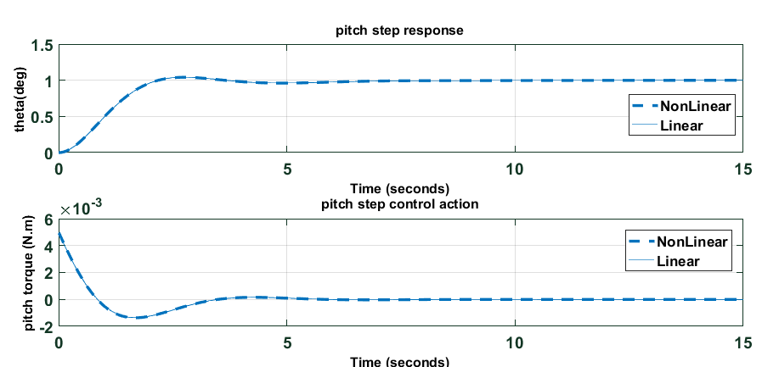
Attitude controller: Pitch Controller
1 deg step response & control action

Slide 23
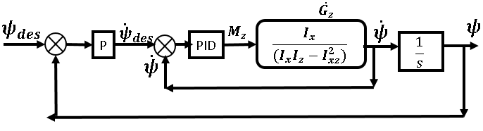
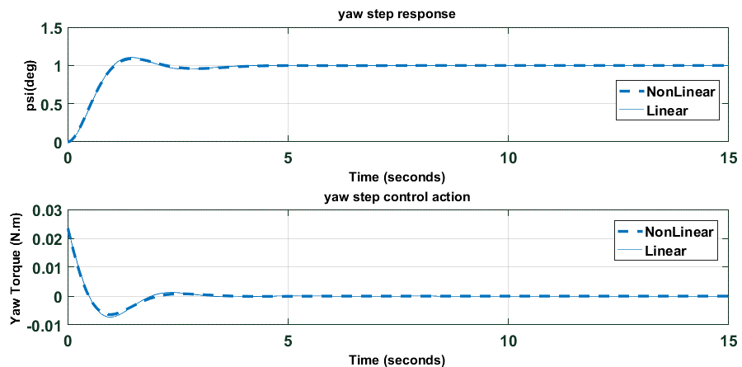
Attitude controller: Yaw Controller
1 deg step response & control action

Slide 24
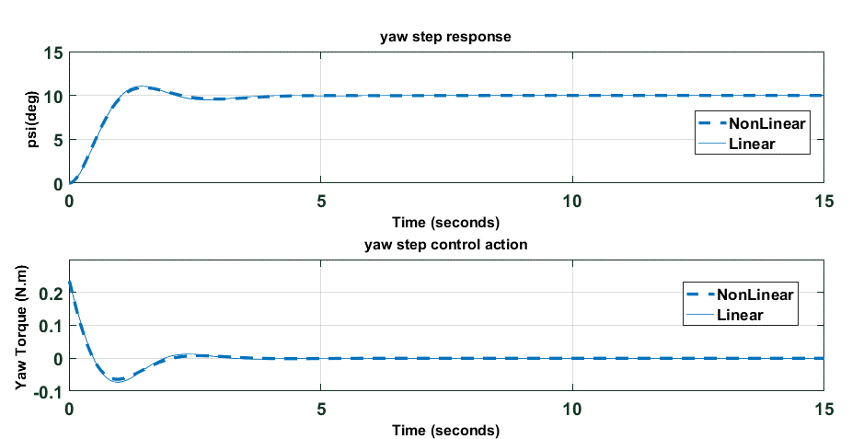
Attitude controller: Yaw Controller
10 deg step response & control action

Slide 25
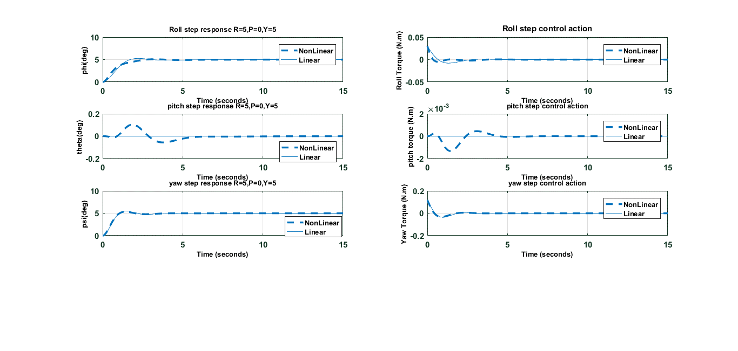
Roll , Pitch and Yaw Controllers together in action:
(Roll = 5deg / Pitch=0deg / Yaw = 5deg) step response & control action

Slide 26
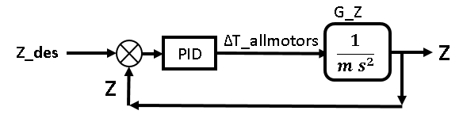
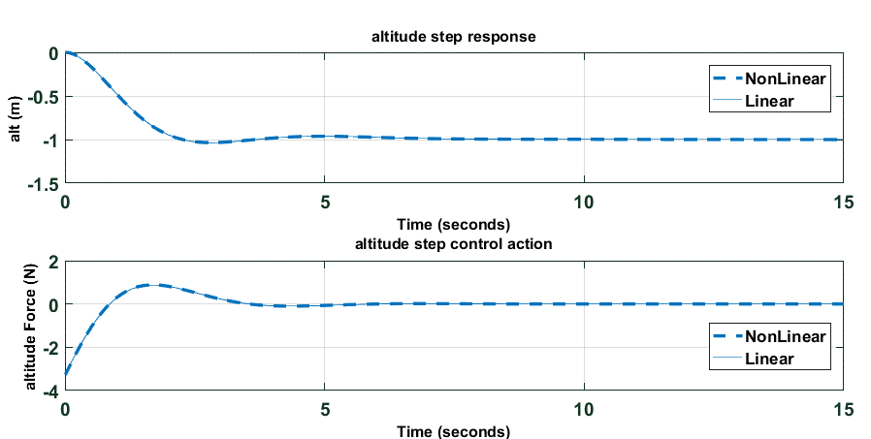
Altitude Controller
1 m (z = -1) step response & control action

Slide 27
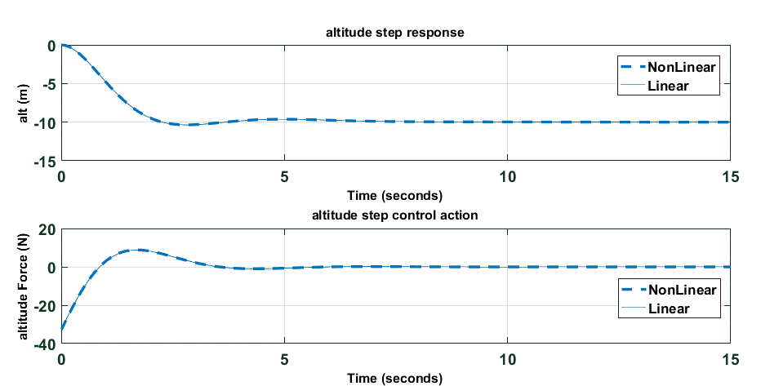
Altitude Controller
10 m (z = -10) step response & control action

Slide 28
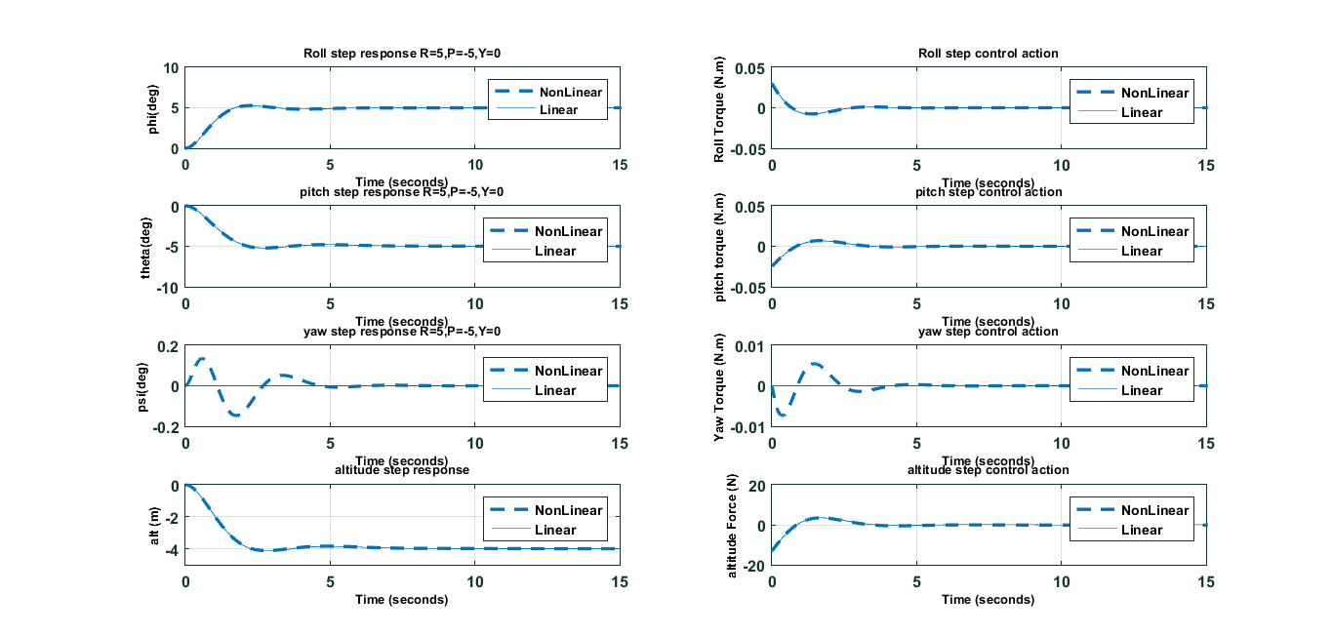
Attitude & Altitude controllers together in action
(Roll = 5deg / Pitch=-5deg / Yaw = 0deg / altitude = 4m) step response & control action

Slide 29
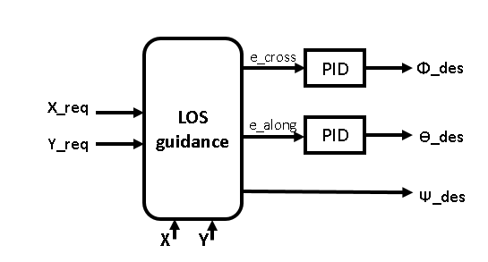
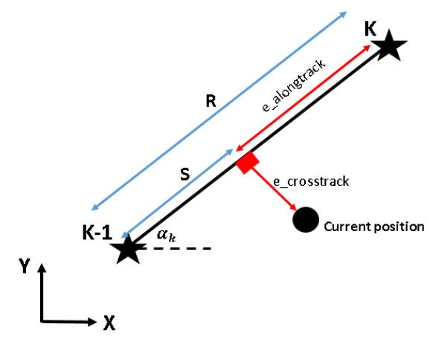
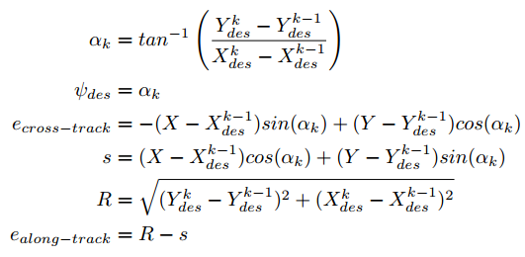
Line-of-sight (LOS) Guidance

Slide 30
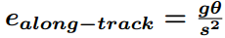
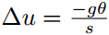
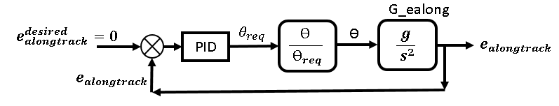
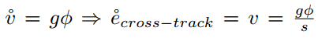
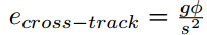
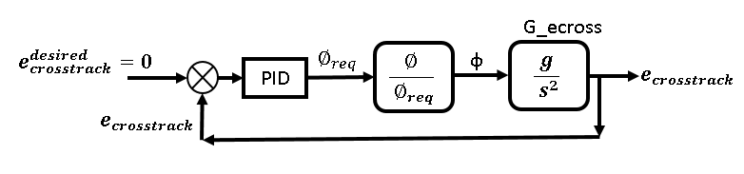

Slide 32
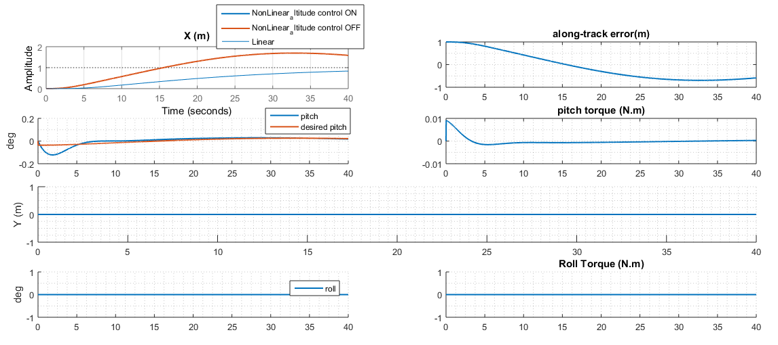
Oscillations with high settling time, we need to increase P , D

Slide 33
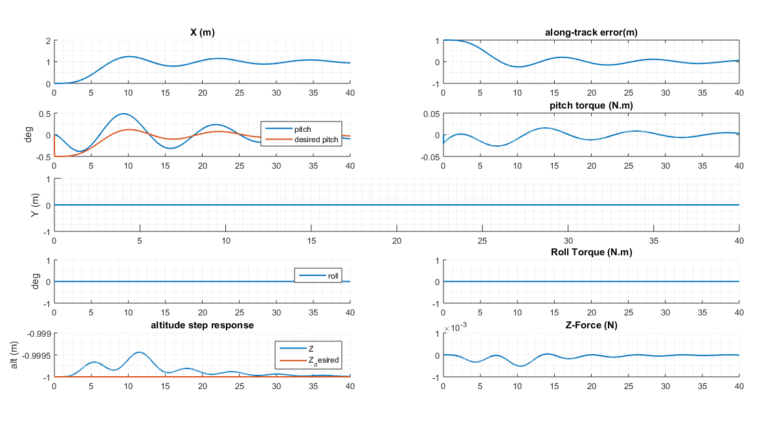

Slide 34
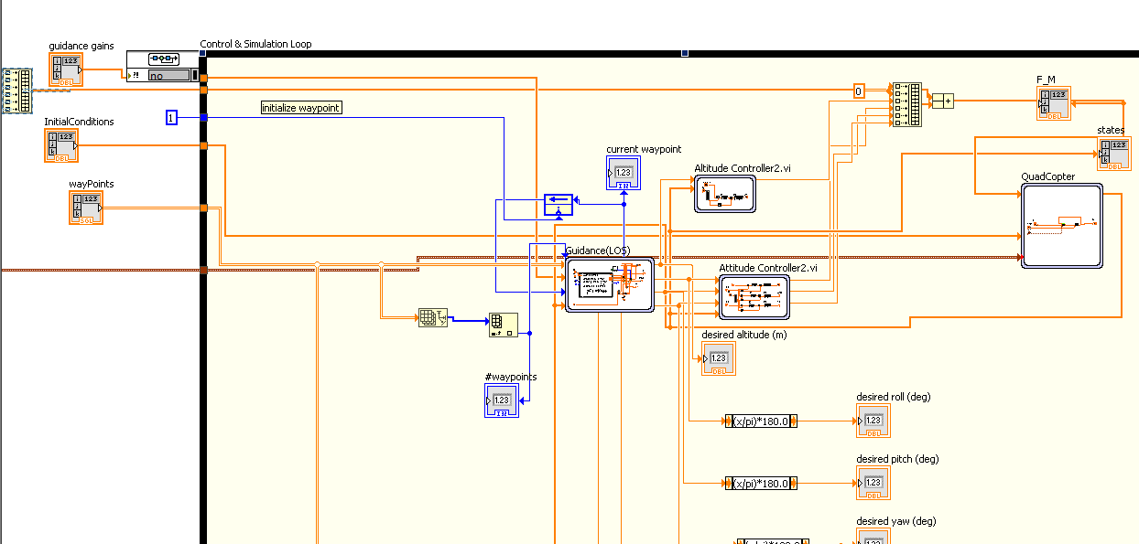
LabVIEW code

Slide 35
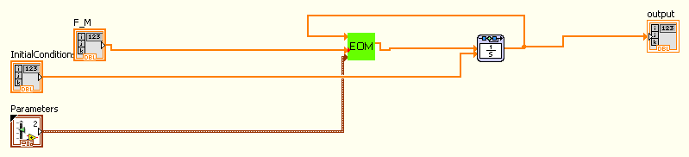
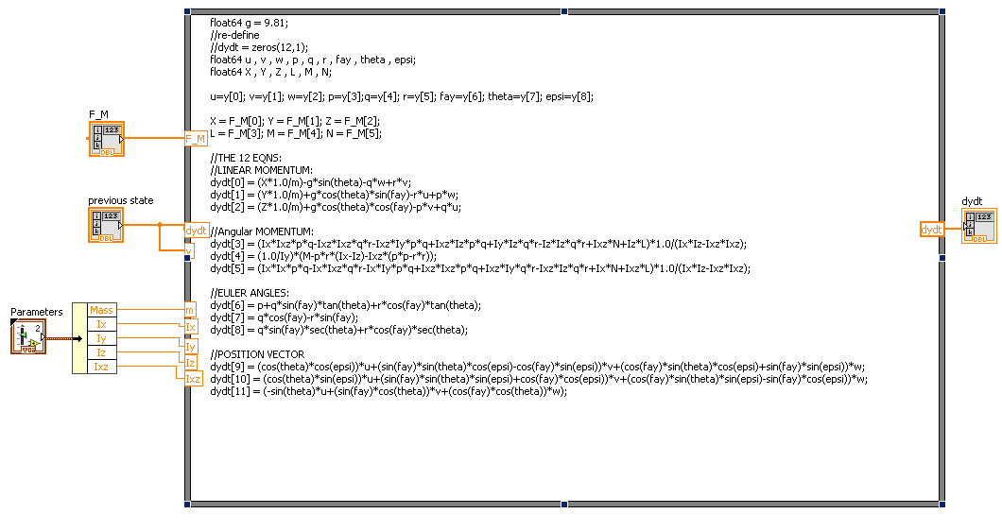

Slide 37
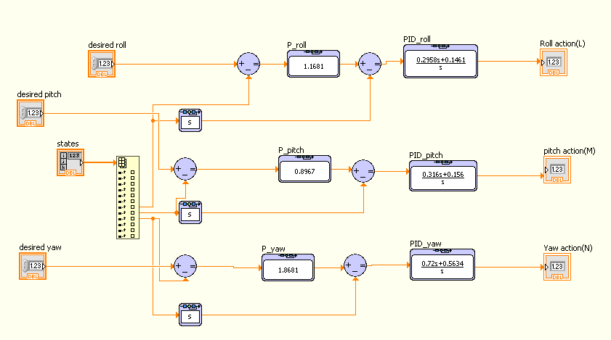

Slide 38
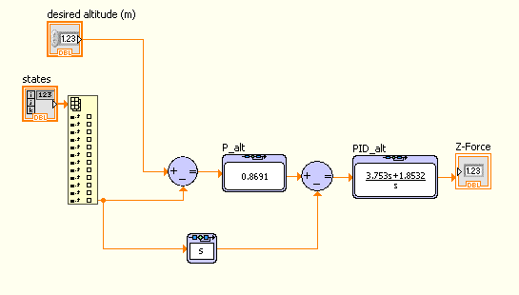

Slide 39
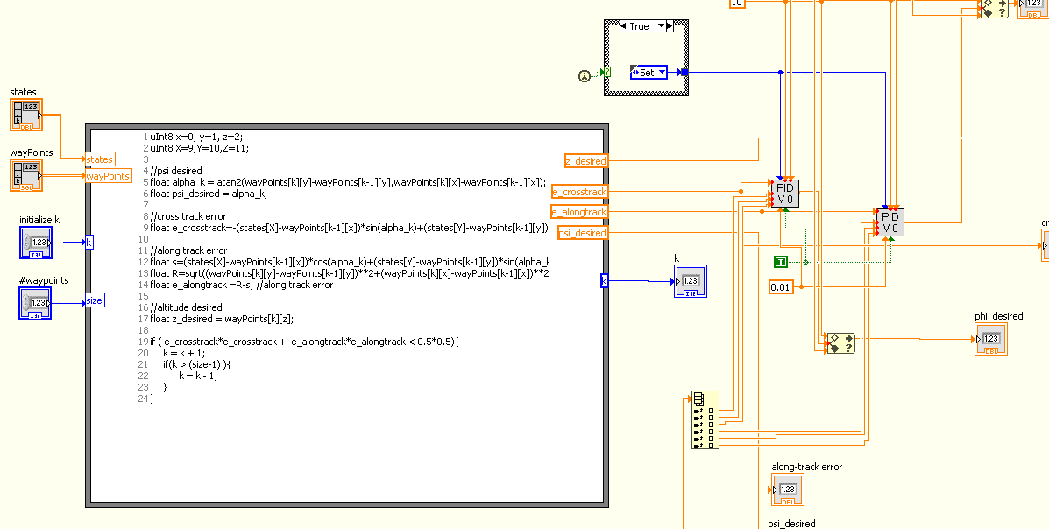

Slide 40
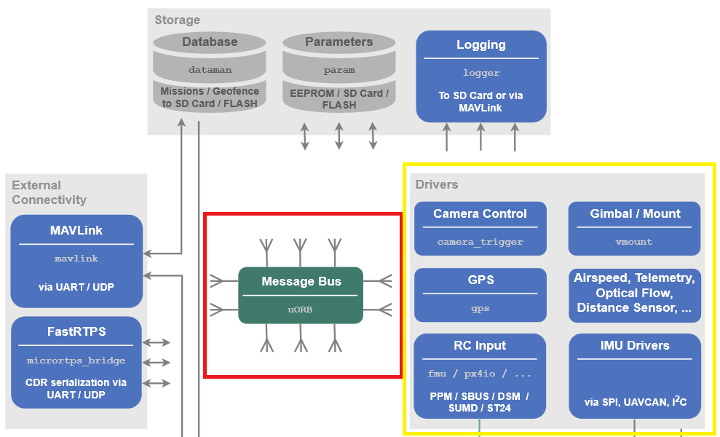
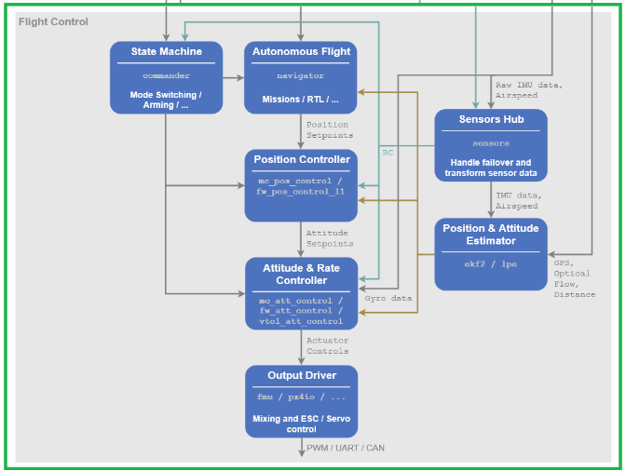
Commercial Autopilot
PIXHAWK is an autopilot hardware for academic, hobby and developer communities and supports flight
stacks software like PX4 and ArduoPilot.
Middleware
Flight stack

Slide 41
Middleware

Slide 42
Flight stack

Slide 43
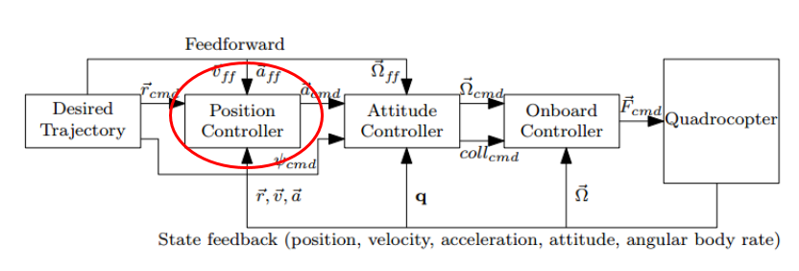
Position Controller

Slide 44
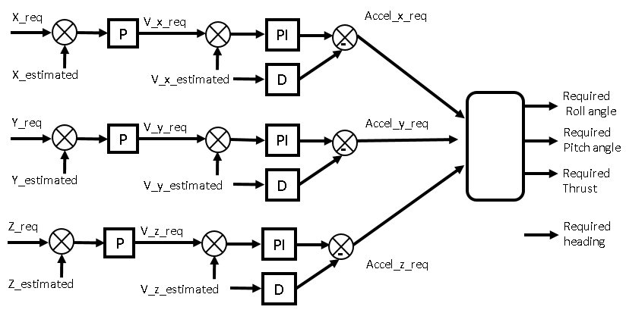
Position Controller

Slide 45
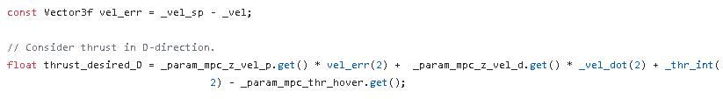
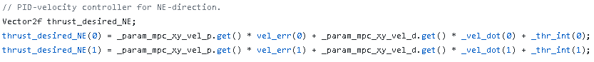
1st Loop : P
2nd Loop : PID

Slide 46
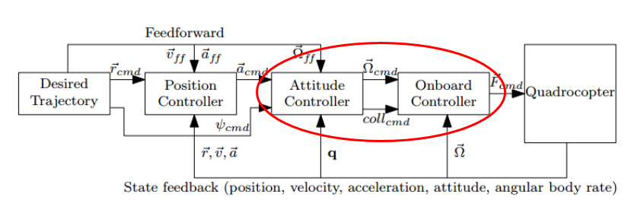

Attitude Controller

Slide 47

1st Loop : P

Slide 48

2nd Loop : PID

Slide 49
some measures to account for the nonlinear behavior of the motor in practice:
Thrust curve method | PID attenuation
Thrust = ( 1-factor ) PWM+ ( factor ) PWM^2 the factor is stored in “THR_MDL_FAC” parameter so we can change it to model our motors characteristics. | after some value of the throttle (for example: 70%) called “break-point”, we can attenuate the gains to decrease the control effort according to a parameter called “rate”. The break-point value is configured using “MC_TPA_BREAK_*” parameters , and the rate is configured using “MC_TPA_RATE_* ” parameters.

Slide 50


Estimators
In PX4 flightstack, there is 4 types of estimators are defined so we can choose the one that suits our application:

Slide 51
Logging
SD card | Log Streaming
The most ecient way for large data size is using SD card on the PIXHAWK where the data is logged. | The Log Streaming way, which sends the same logging data via MAVLink. The requirement is that the link(for example WiFi) provides at least 50 KB/s and only one client can request log streaming at the same time. The connection doesn't necessarily need to be reliable because the protocol can handle drops.

Slide 52


Quad-plane phase cruise controller

Slide 53

step response & control action

Slide 54

impulse response & control action

Slide 56


Implementation
Why ROS ?

Slide 57


some important features in ROS
ROS master
ROS nodes
ROS topics
ROS messages
ROS packages
ROS services
ROS actions

Slide 58

increase our experience in ROS and Its features
Deferential Drive Robot (DD robot)

Slide 59

Objective
Control the DD robot linear velocity and angular velocity
Localize the DD robot by fusing the data from IMU and odometry from encoders

Slide 60

Block Diagram

Slide 61

1D Bi-rotor
validate ROS performance in aerospace applications
Block Diagram
Conjuration 1 (ROS PID) (Low-pass filter on derivative term)

Slide 62

Controller Tuning in Real time

Slide 63

Configuration 2 (PIDA)

Slide 64

Results & Conclusions
Sampling Time
Comparison between configuration 1 and Configuration 2 sampling time

Slide 65



Effect of not constant Sampling time
Put $K_{d}$=$K_{I}$=$K_{a}$=0 , $K_{p}$=value ,Hence Controller=$K_{p}=error=−K_{p}∗state$
$$T_{s}=\text{Constant}$$

Slide 66


$$T_{s}≠\text{Constant}$$

Slide 67


Gains tuning (Comparing between ROS and my PID controller)
(a) $K_{p}=60 , K_{I}=10 , K_{D}=30$, cutto-freq (Low pass lter on derivative term) = 40 Hz

Slide 68


Gains tuning (Comparing between ROS and my PID controller)
(b) ${ROS pid K}_{p}=60 , K_{I}=15 , K_{D}=30$, cutto-freq (Low pass lter on derivative term) = 40 Hz ,and same gains for my PID but adding $K_{a}=10$ (to resist error acceleration)

Slide 69

Comparing between ROS and my PID controller on one graph

Slide 70

Comparing between ROS and my PID controller on one graph

Slide 71

PX4 autopilot(PX4 , ROS and Gazebo)

Slide 72

MAVROS and MAVLink messages interpretation

Slide 73
Position Control Using(PX4,Gazebo simulation,MAVROS)
Our simulation simple test

Slide 75

Flying Test

Slide 76

Wiring
The first problem was to connect all the components together and get the vehicle started .

Slide 77


Ground Stations
Qgroundcontrol
Mission Planner
Open source
Cross platform
Simple to use
Easier for calibration
Open source
Simple to use
Easier for logging flight data

Slide 78


Installing firmware and selecting airframe

Slide 79


Radio Calibration (DX8)

Slide 80




Sensors calibrations
Compass
Gyroscope
Accelerometer
Level horizon

Slide 81

ESCs and Battery calibration

Slide 82




Tuning
Hovering thrust
Pitch
Roll
Yaw

Slide 83


Flight modes
Manual / stabilized
Acrobatic

Slide 84


Flight modes
Altitude
Position

